Slide 1
A RESTFUL DYNAMIC WEB MODULE TO MANAGE AND MAINTAIN THE CHIT FUND SYSTEM
M.Gomathi - 117003062

Slide 2
Problem Statement
Goal
to develop a RESTful API for a dynamic Maven web project, a Chit Fund System.
Chit Fund System
The chit fund system, more like a small finance system, developed integrates all the features required from viewing the details as a table and chart to transferring money to the clients.
Risks
Development of money transfer API in short duration

Slide 3
Steps Involved
Requirement Analysis
Development
Testing
Requirement Analysis
Database Dependencies Included
Core entity is built using JAVA
REST web services are developed
UI is developed using Bootstrap, AngularJS
Integration of Back End with the Front End
Testing

Slide 4
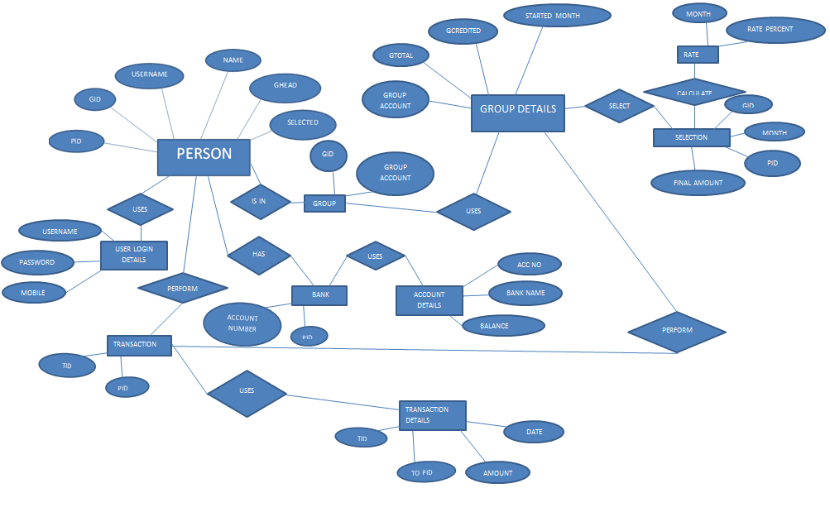
ER Diagram

Slide 5
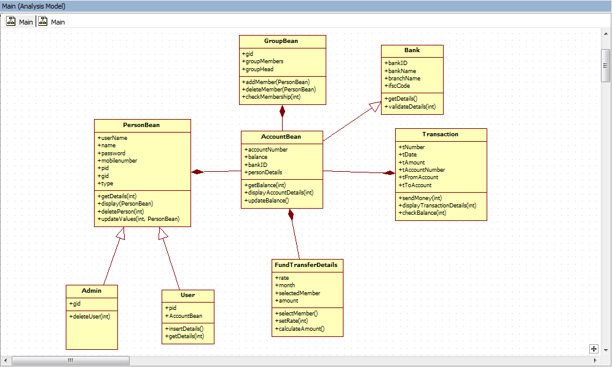
Class Diagram

Slide 6
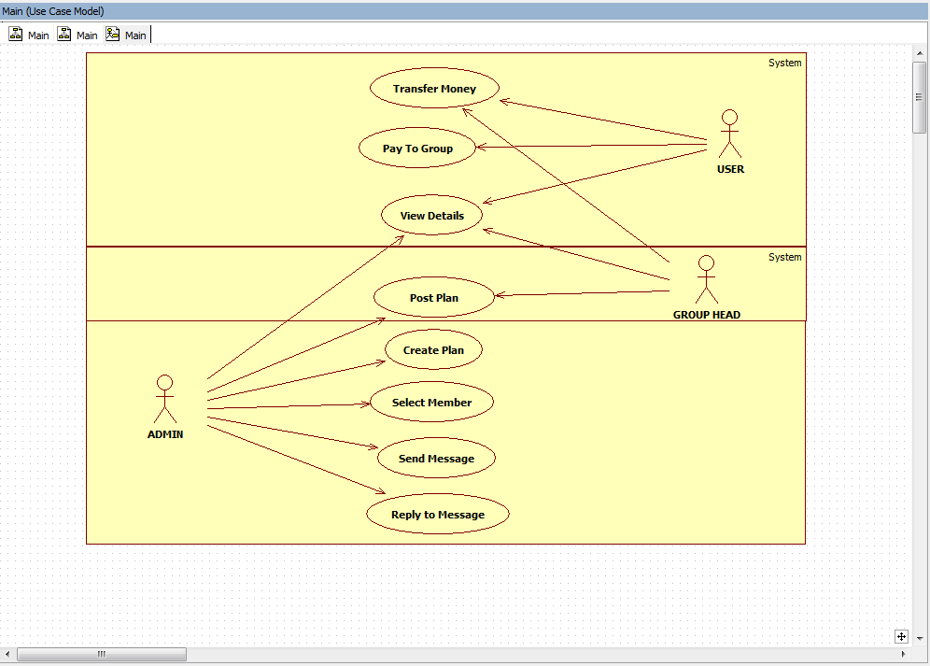
Use Case Diagram

Slide 7
Technologies-Frameworks Used
JAVA
Spring
Maven
HTML, CSS, JS
AngularJS
Bootstrap
Jquery
Chart API

Slide 8
Spring Framework
It provides a model-view-controller architecture and in built components that are used to develop flexible and loosely coupled web applications.
The MVC pattern helps in separating the different parts of the application like
UI logic
business logic
input logic
by providing a loose coupling between these elements.

Slide 9
Spring Framework
Model – Every class are developed according to the Spring modal. Every possible interaction, use cases has a set of bean classes, DAO classes, interfaces, Services, repositories.
View – All the view components like html, jsp are under different modules. Angular components are used under directives for reusability.
Controller – RESTful API is separated as controllers and used to pass data to and from the back end to the angular modules.

Slide 10
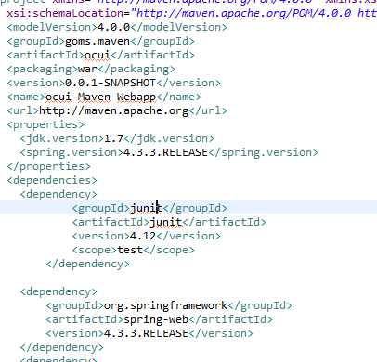
Maven
A software project management tool that allows a developer to develop based on project object model(POM).
All the dependencies are included in the POM.xml file

Slide 11
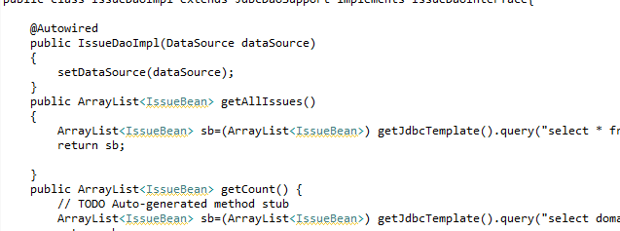
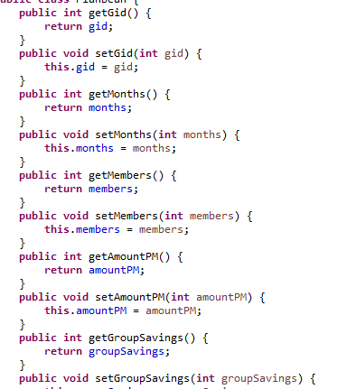
Model

Slide 12
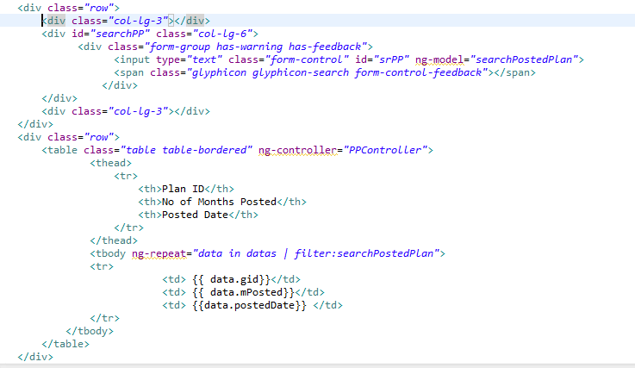
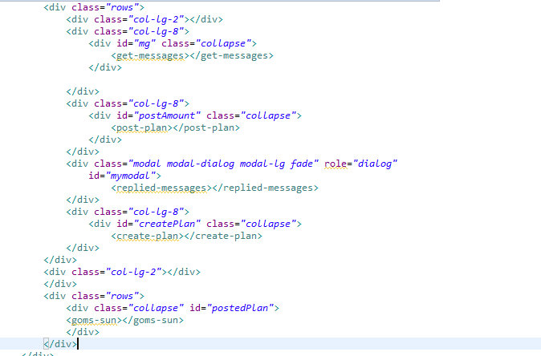
View

Slide 13
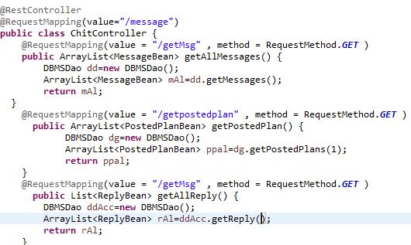
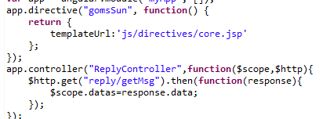
Controllers

Slide 14
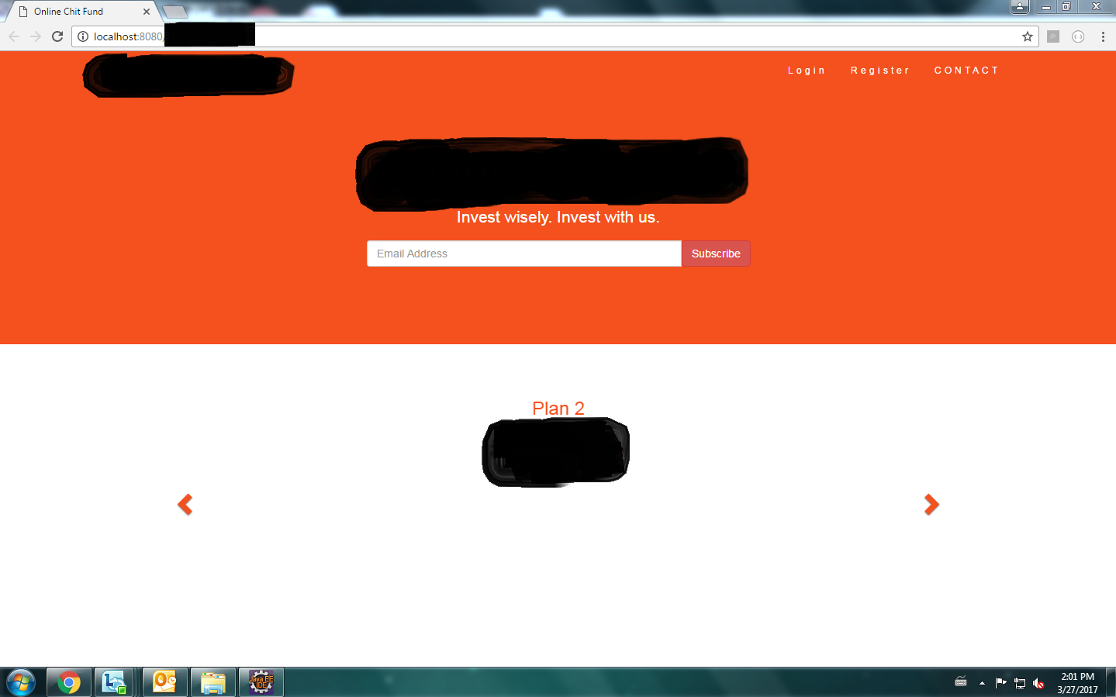
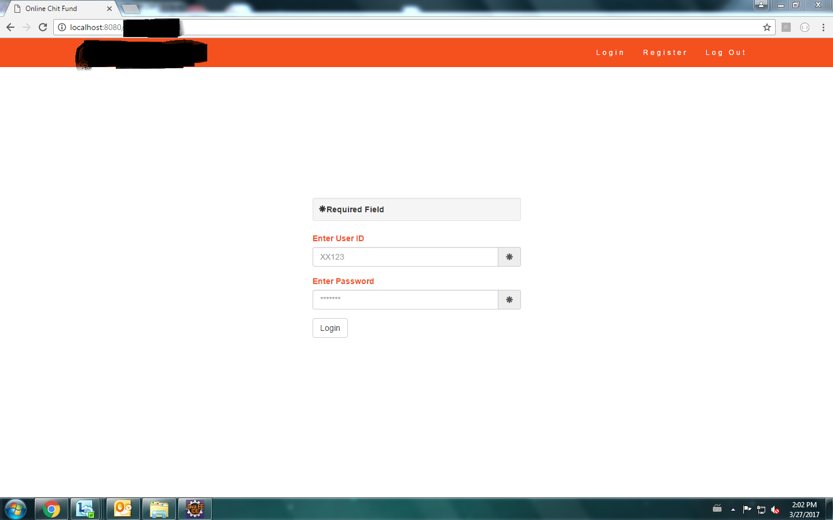
UI Sample

Slide 15
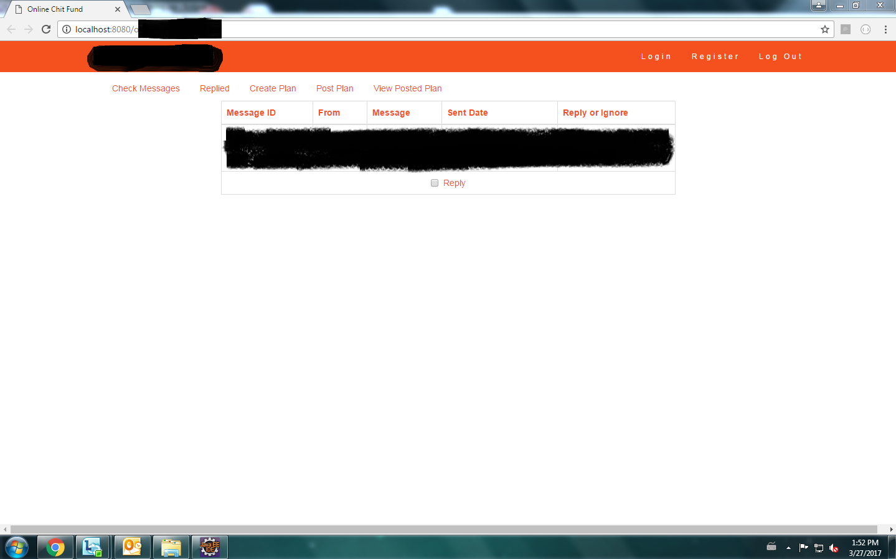
UI Sample

Slide 16
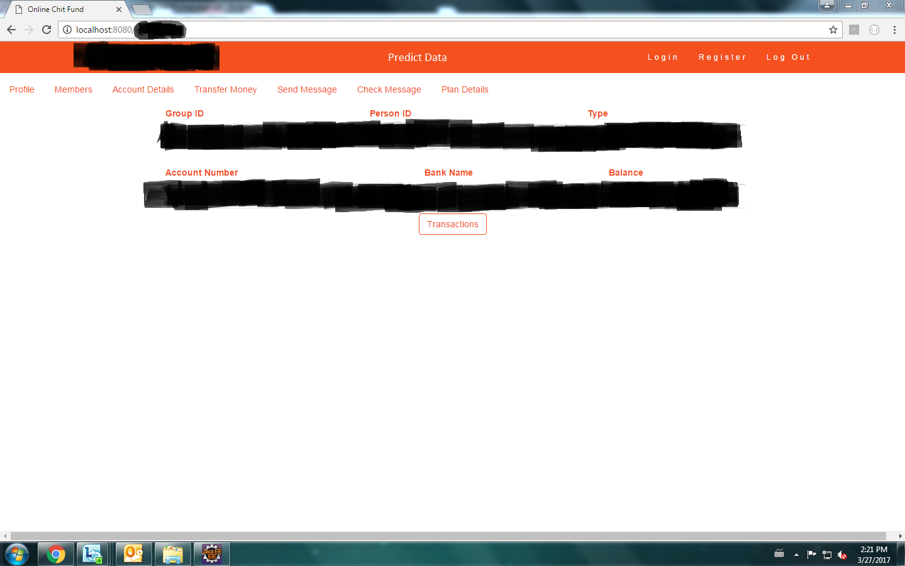
UI Sample

Slide 17
Future Works
The chit fund system will be integrated with NEXEN, an open-source, cloud-based technology platform
REFERENCES
https://inautixonline.inautix.com

Slide 18
THANK YOU!

